Slide 1


SAP UI5 & FIORI with OData TRAINING using BAS
Anubhav Oberoy
Day – 17

Slide 2

Agenda – Day 17
Responsive Table (sap.m.Table)
Drill Down using the Table
Messages in UI5
Drop Down
Object Status
Fragments

Slide 3
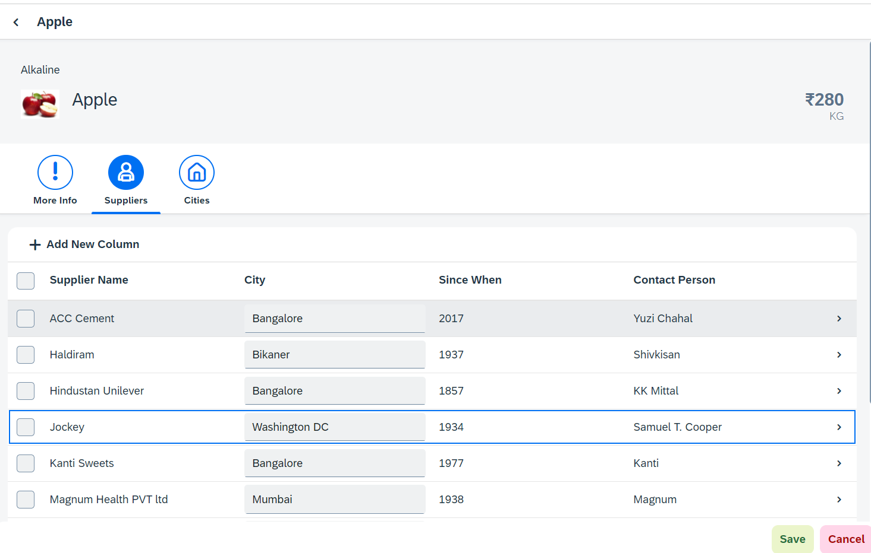
Hands – on: Sap.m.Table (Responsive Table)
Now in the second section of the icon tab filter bar we will add a Responsive table containing the Supplier Data.
Along with that we will add a button in the Header of the table to add a new column.
And on select of a row in the table the table path will be shown in alert message.
Code Link:-
View2.view.xml
View2.controller.js

Slide 4
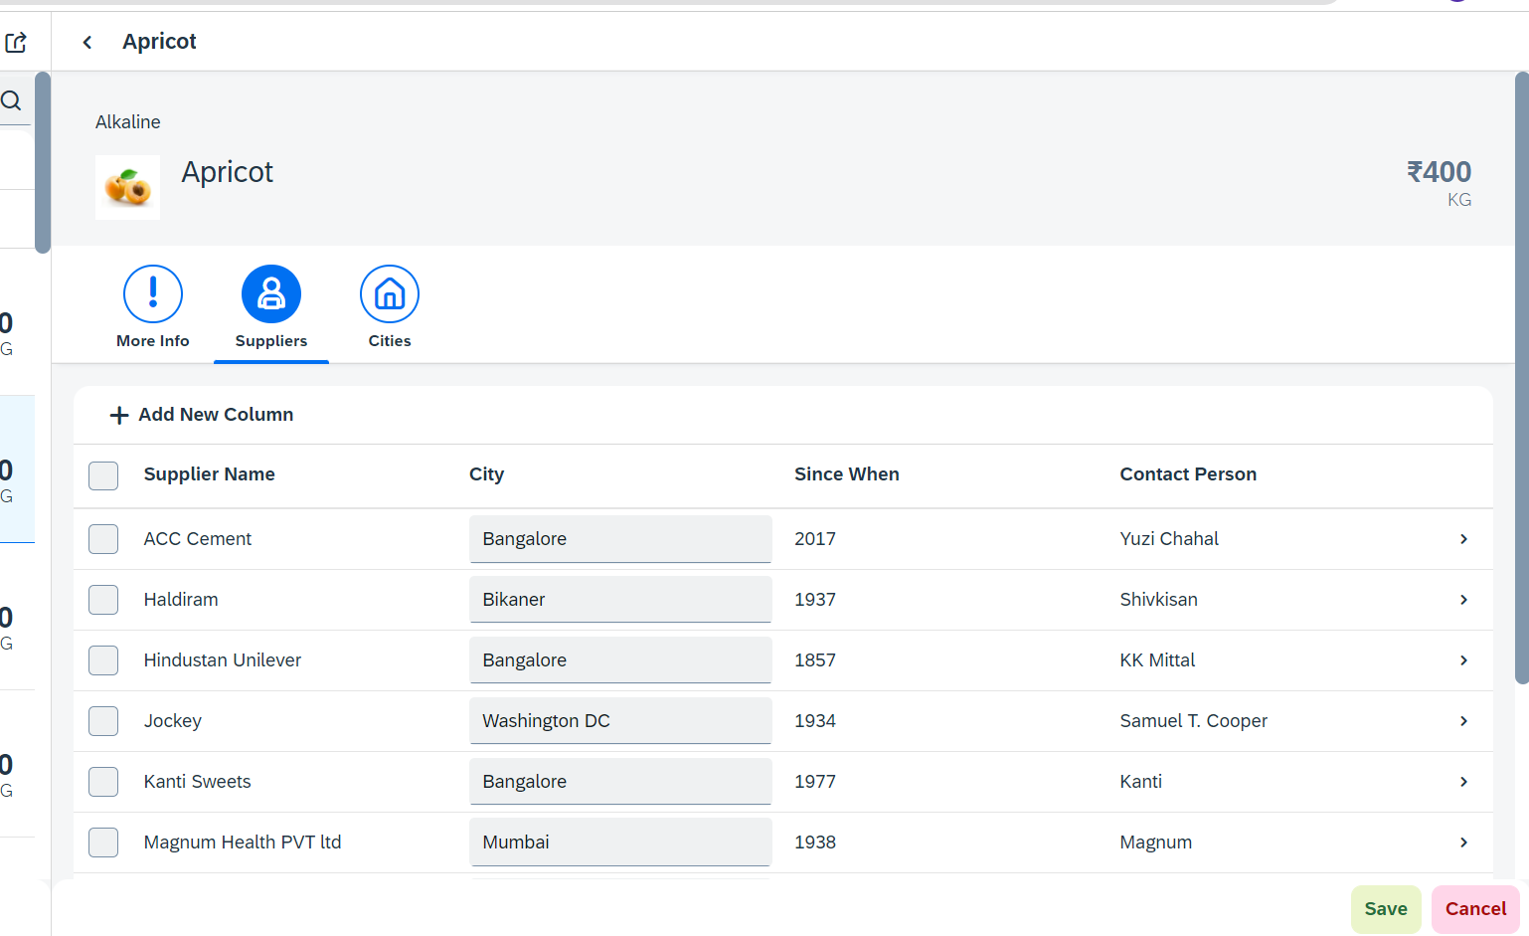
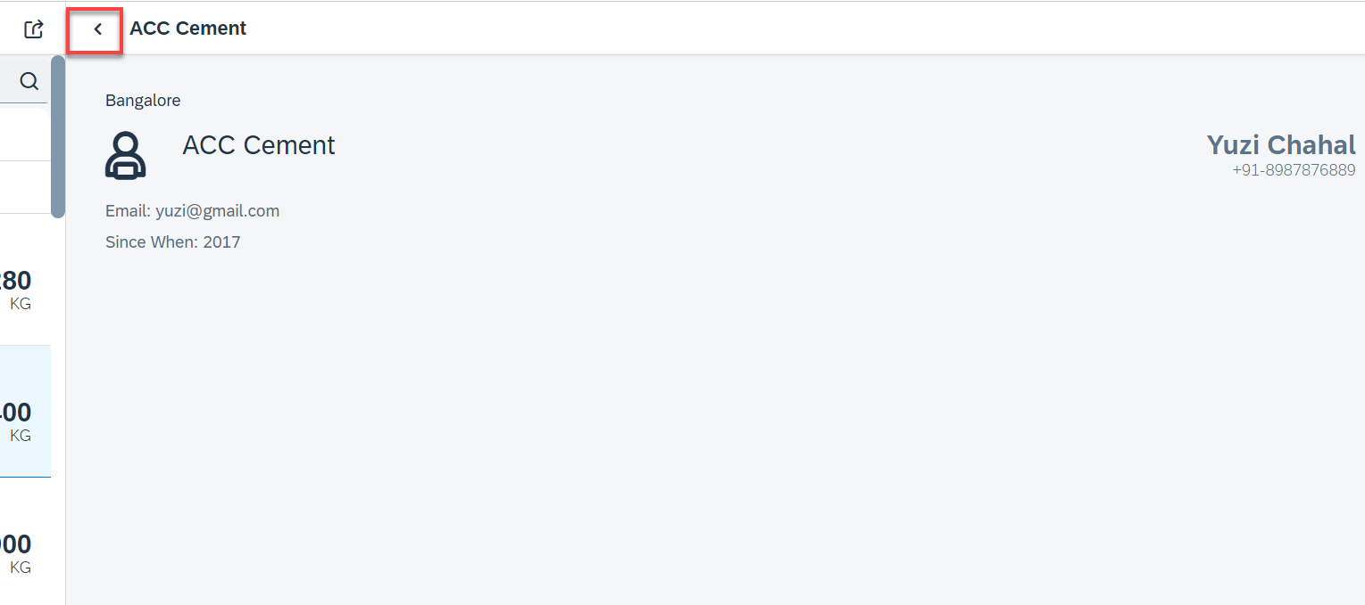
Hands – on: Drill Down from Table and Nav Back
Now we drill down to a new screen where we will show the supplier data for that we will create a new supplier view.
Along with that we will also add the back button login to go back using a nav button on the supplier view.
Code Link:-
View2.controller.js
Supplier.view.xml
Supplier.controller.js
BaseController.js
manifest.js
The nav back logic is written in BaseController so that it can be used at multiple places.

Slide 5
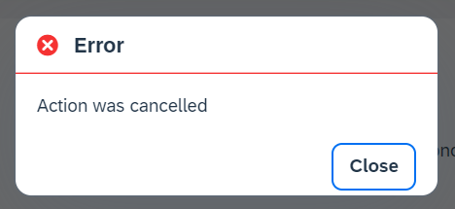
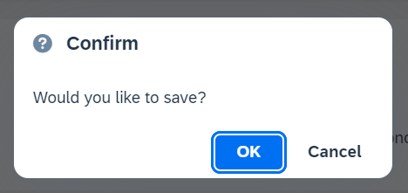
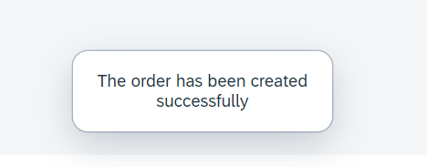
Messages in UI5
The system generates messages in response to what users do in the SAP system. A message presents information, an instruction, or a warning to users in a given situation.
Messages can be used to notify the user about specific states of the application and can help the user to correct their incorrect inputs.
For showing messages to the user that are related to the current page, you have several possible controls. Each of these offers a different type of interaction from the user. Choose the control that fits best in you interaction pattern.
Message Dialog: A message dialog interrupts the user's workflow by blocking the current page and needs to be closed by the user.
Message Toast: A message toast is an overlay that disappears after some time or if the user taps somewhere else. It does not block the user.
Message Box of type error
Message Box of type Confirm
Message Toast

Slide 6
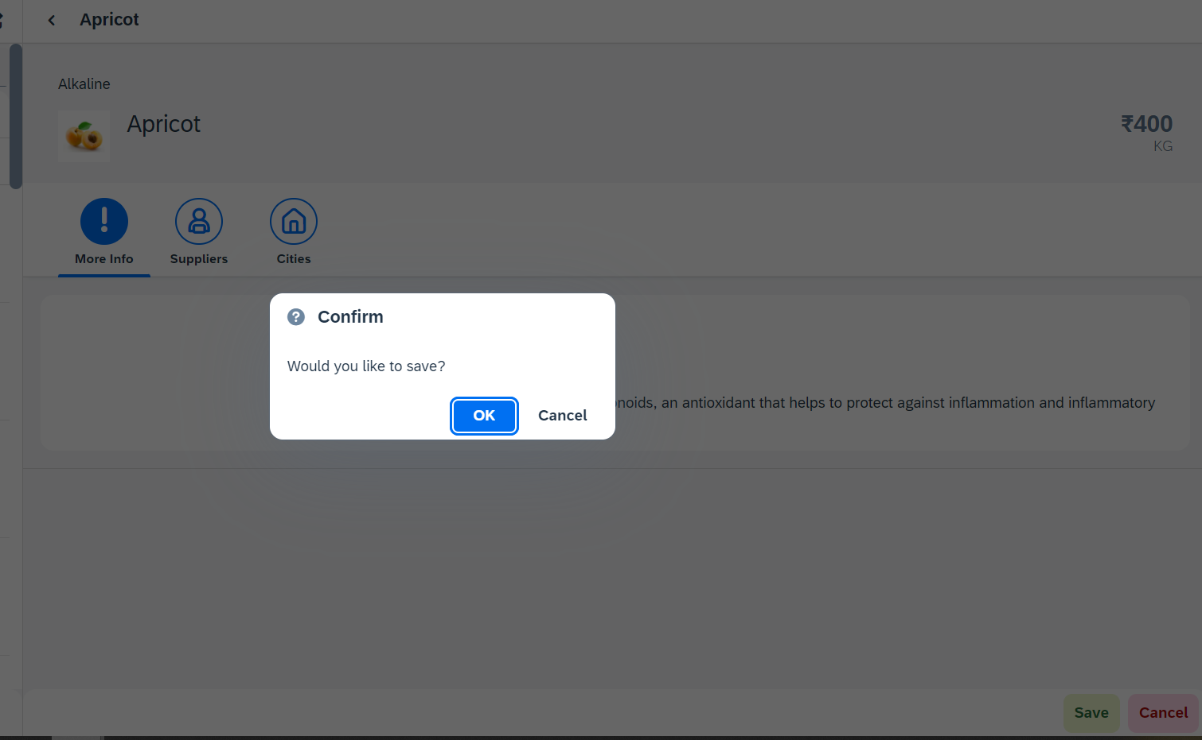
Hands – on: Messages
Now we will see how to use the messages in the ui to get users conformation or to show error to the use.
For this we will see the example of Message Box and Message Toast.
Code Link: -
View2.view.xml
View2.controller.js

Slide 7
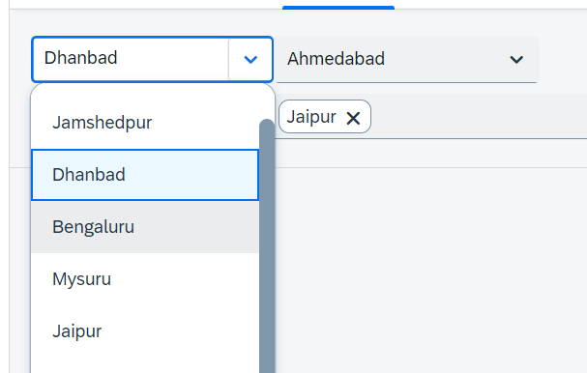
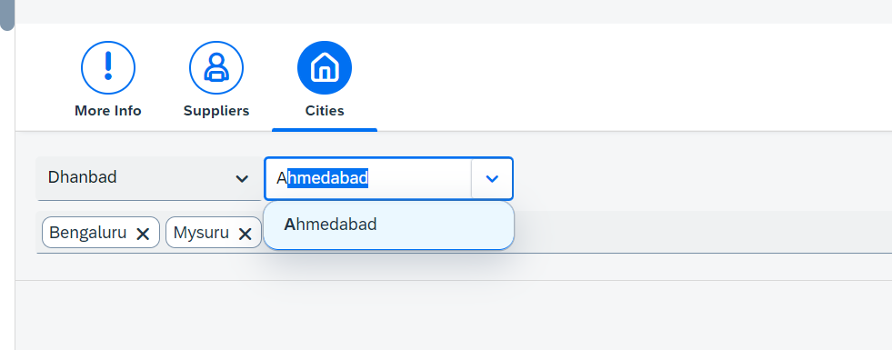
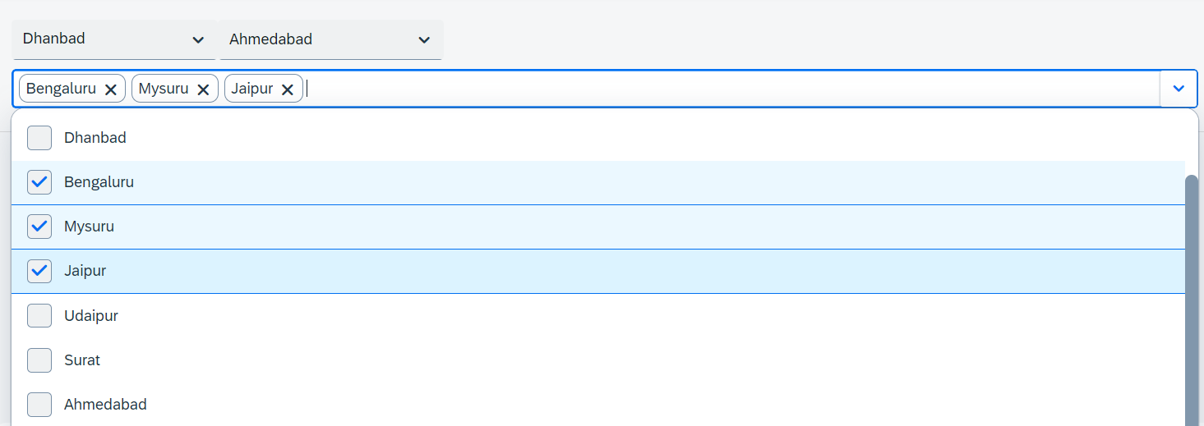
Hands – on: Drop Down Controls
Now we will see the example of some Drop Down Controls present in UI5.
We will load the cities data in the different types of drop downs to see their functioning.
Code Link:-
View2.view.xml

Slide 8
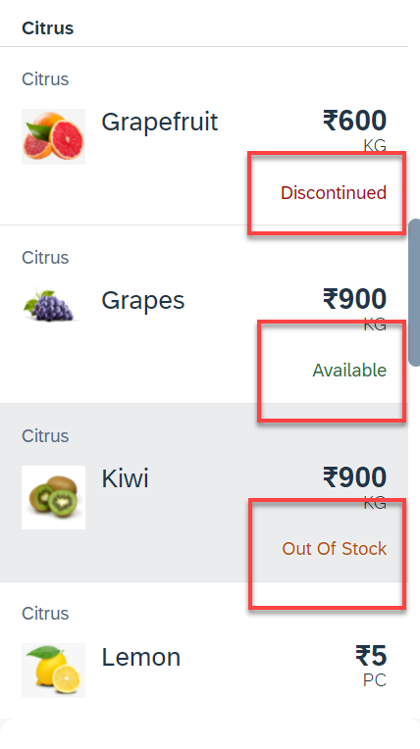
Hands – on: Object Status
Some time we want to show the status any item in different colors, as in our case we want to show the availability of a fruit in different colors like Available, Out of Stock, Discontinued.
For this we will add the object status attribute in the Object list item in View1.
Code Link:-
View1.view.xml
View1.controller.js
formatter.js

Slide 9
Fragments
Fragments are light-weight UI parts. They are used to modularize views. We can reuse a fragment multiple times in same view or other views.
Fragments are used similar as sap.ui.core.mvc.Views, but Fragments do not have their own controllers. Logic related to fragment’s UI elements is written in the host view’s controller.
Fragments are like parasite, they rely on the controllers of the host views.
There are 2 techniques to create and work with fragments
Direct embedding using fragment
Use JS class sap/ui/core/Fragment and use load function to load it
View1
Controller1
Address – street, house, city, country
fragment
B
Event for fragment button
fragment
B
View 2
Controller2
fragment
Event for fragment button
B

Slide 10

End of Day 16

Slide 11

Questions

Slide 12
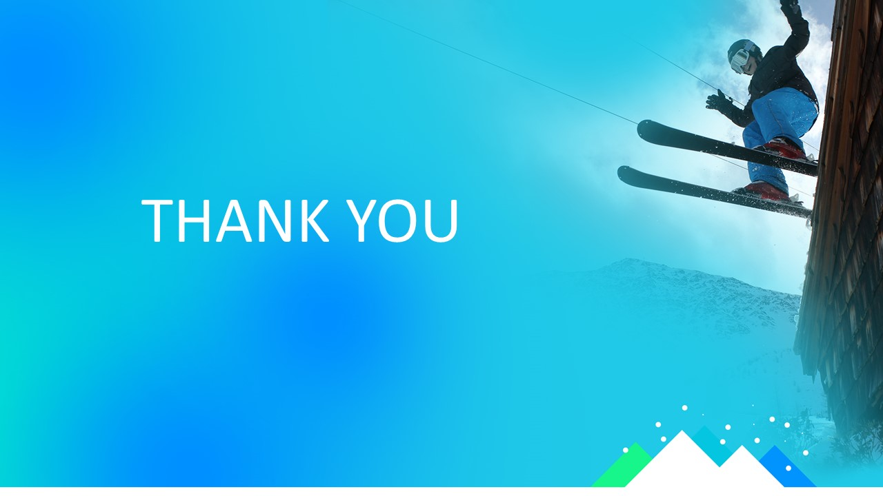
Sakshi Gupta

Slide 13


We’re committed to empower you to be
Most Desirable Resource
through powerful training solutions.
We build the workforce of the future.
250+
Corporate Clients
30,000+
Learners Trained
25000+
Learners Placed
FREE WEBINARS
Sign up for free webinars with industry experts every fortnight!
Enroll Now!
Contact us today!
https://anubhavtrainings.com/

Slide 14
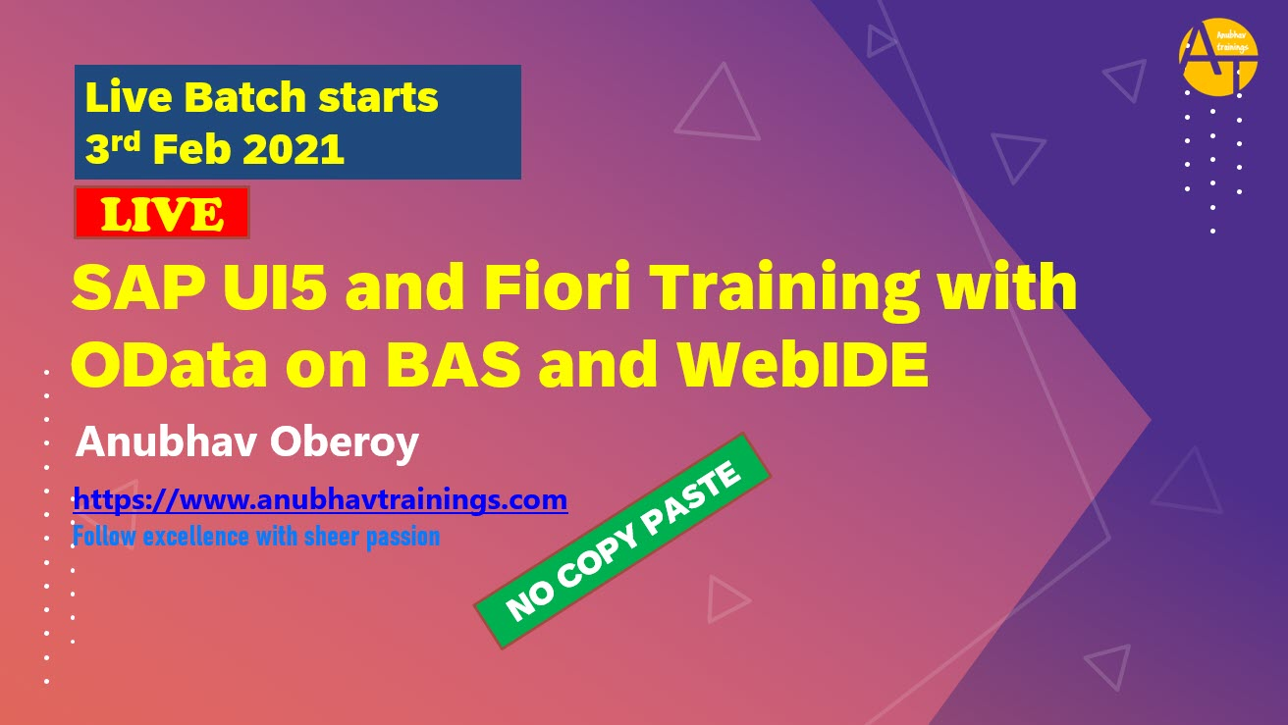
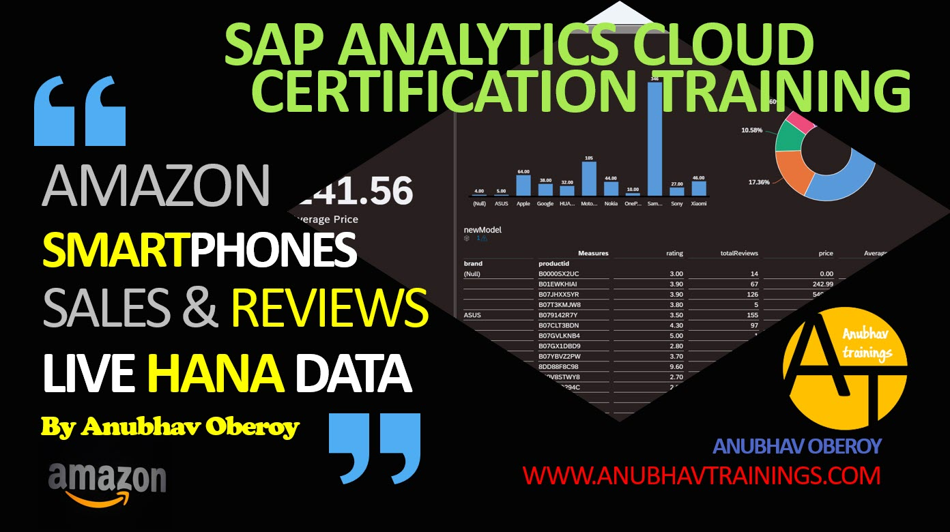

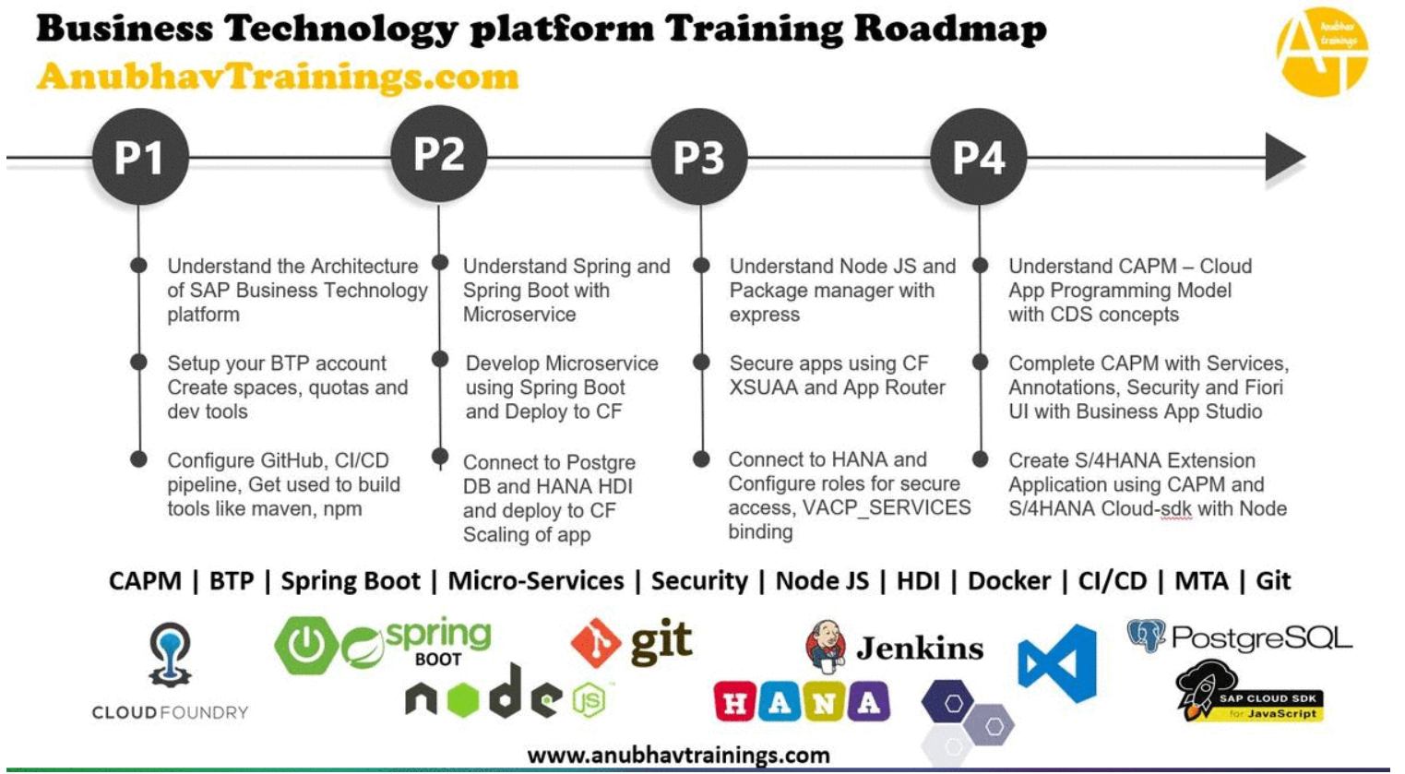
More from AnubhavTrainings.com

Slide 15
Title
Content

